Slide 2
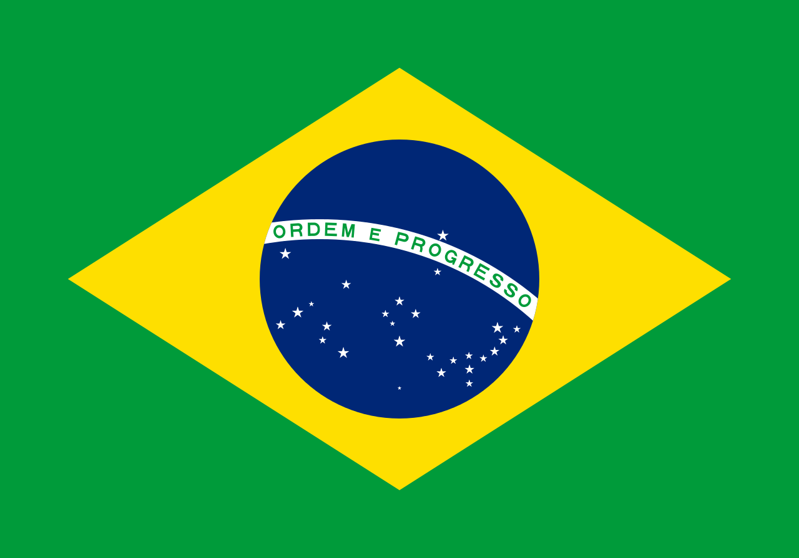

Slide 3
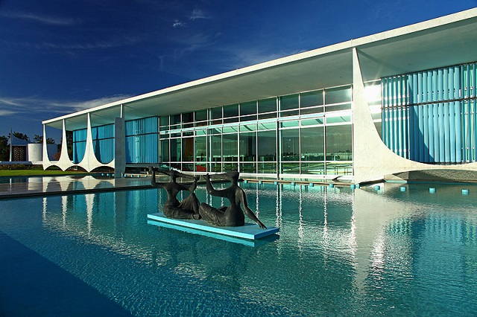
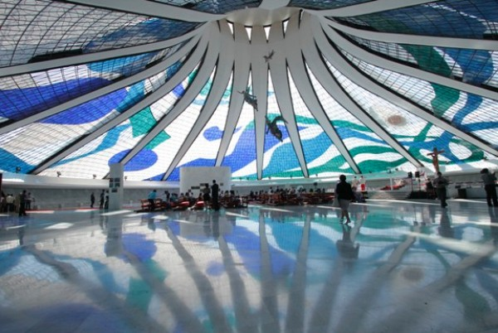
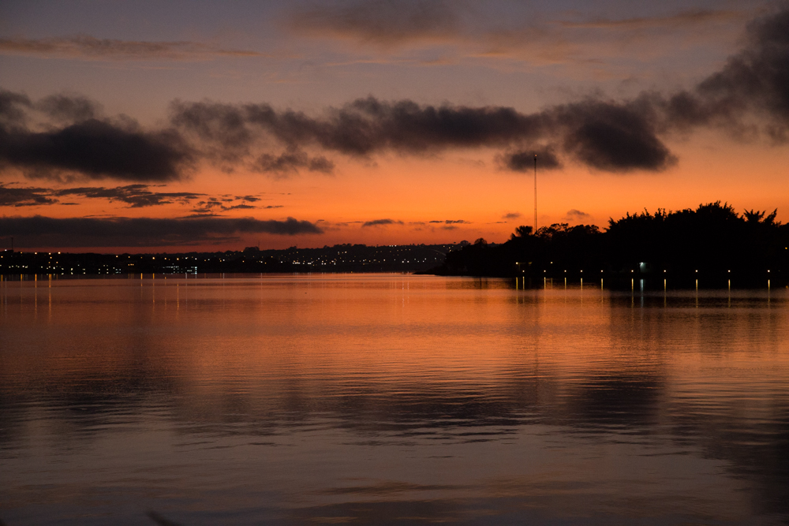
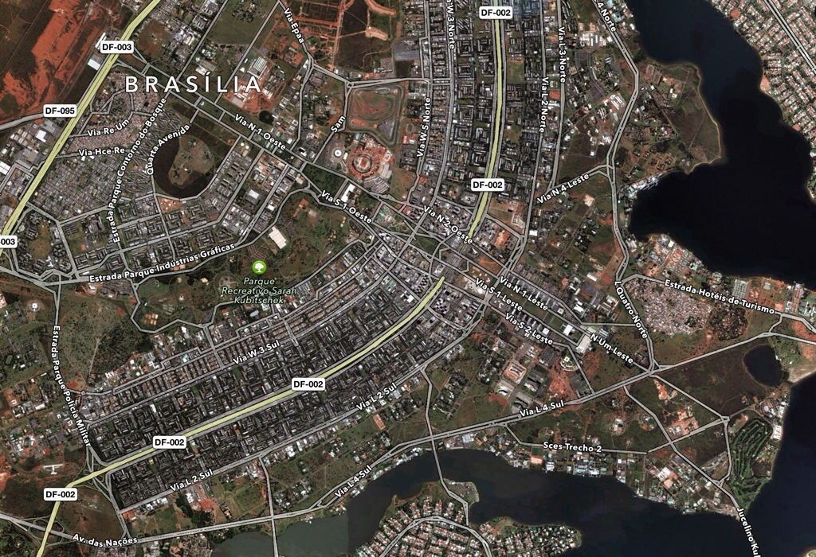

Slide 4
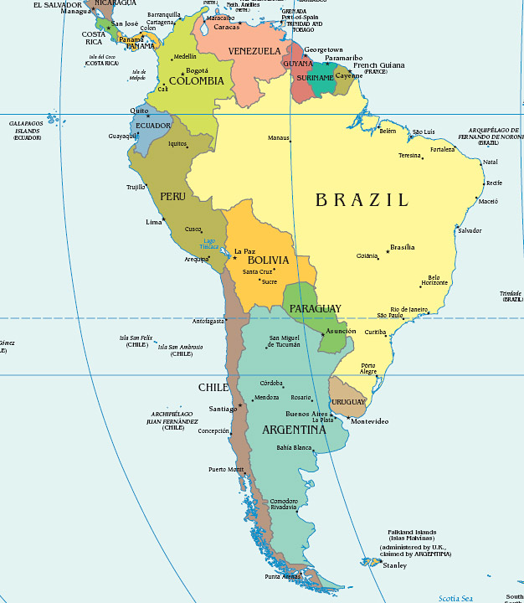
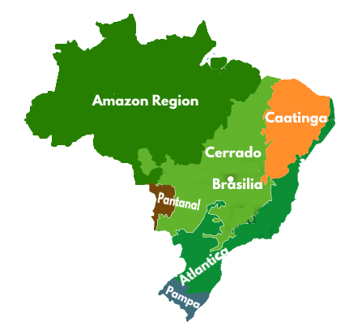
Major Cities:
Brasilia
Rio de Janeiro
São Paulo
Manaus
Natal
Recife
Major Regions:
Amazonus
Caatinga (Desert)
Cerrado (Savanna)
Pantanal (Swamplands)
Atlantica (Coastline)
Pampa (Grasslands)

Slide 5
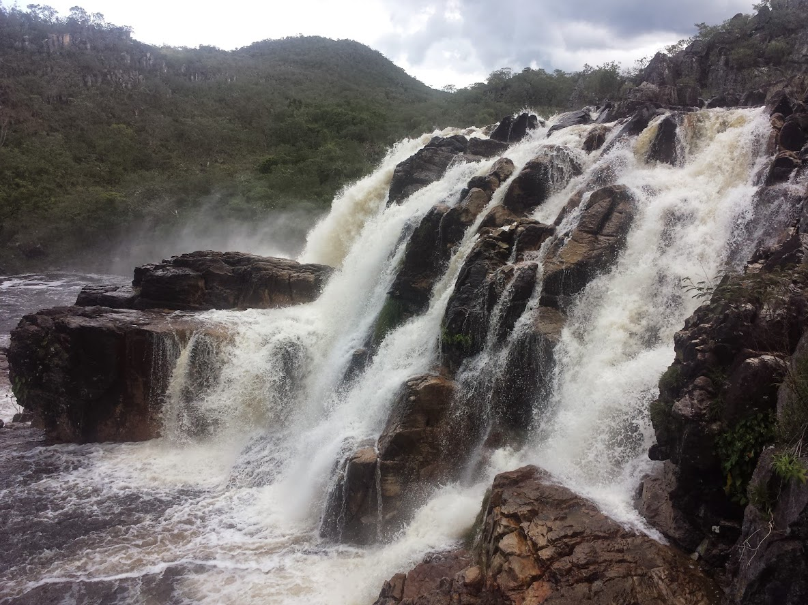
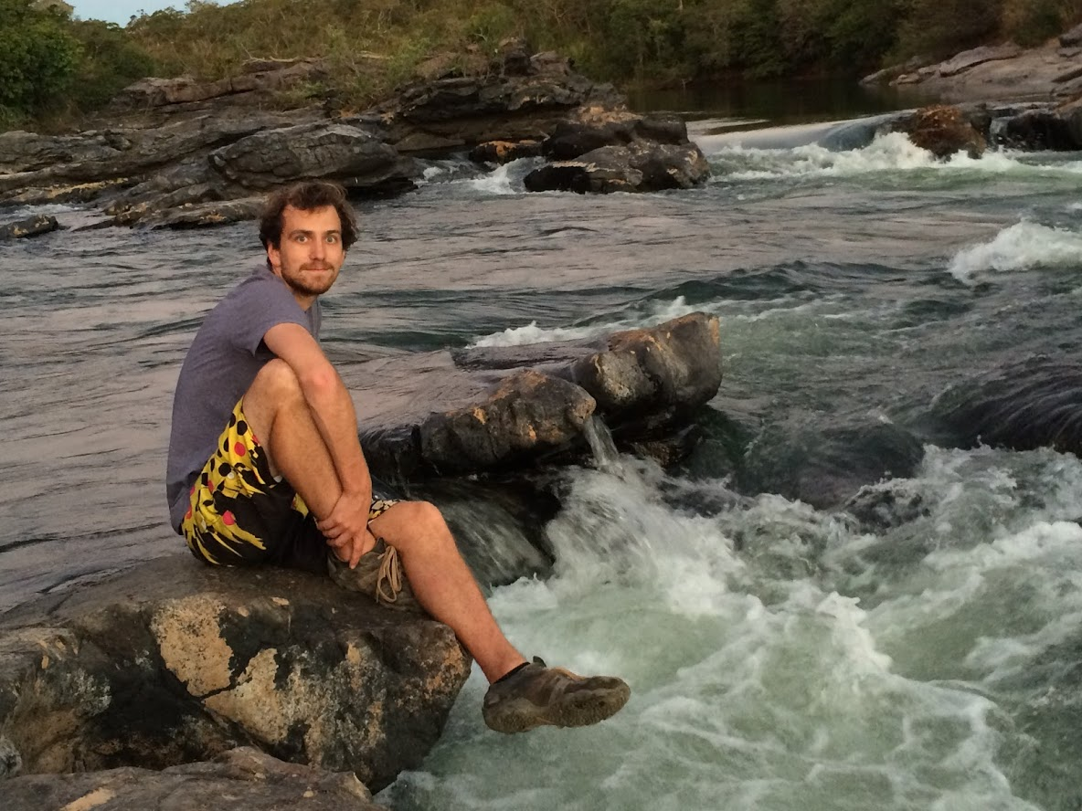
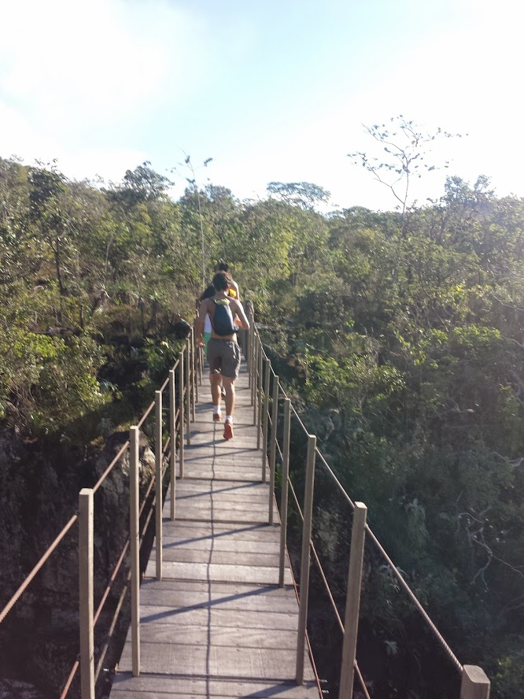
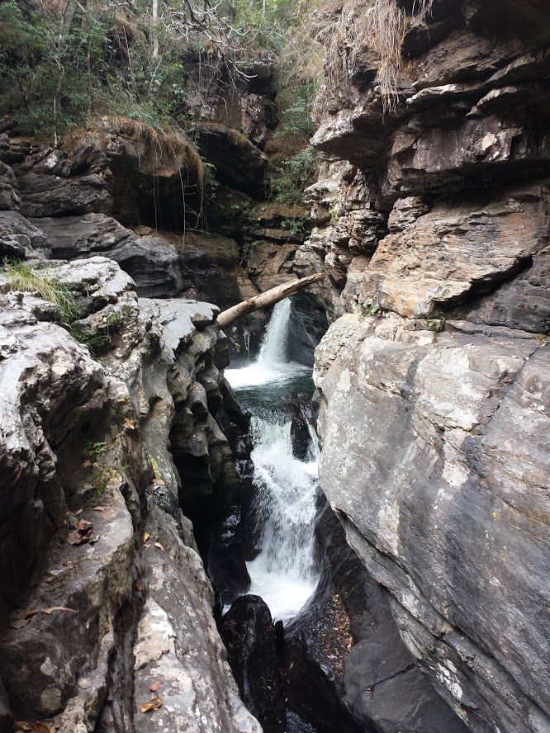
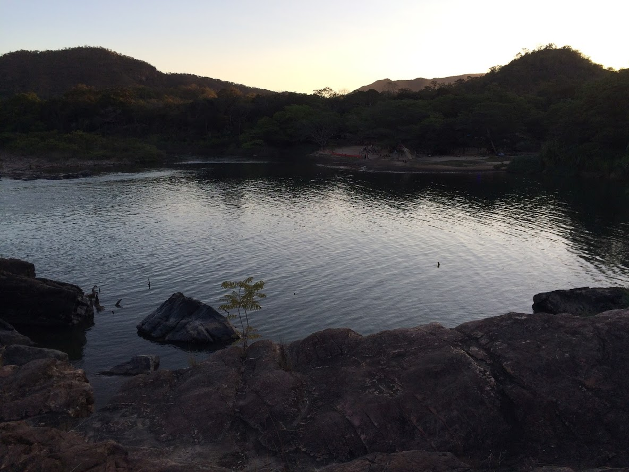
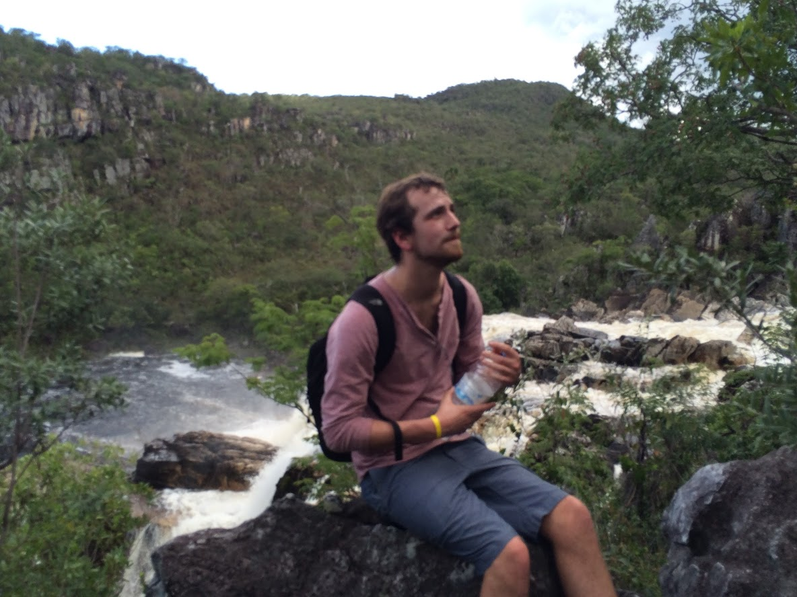
CHAPADA DOS VEADEIROS

Slide 6
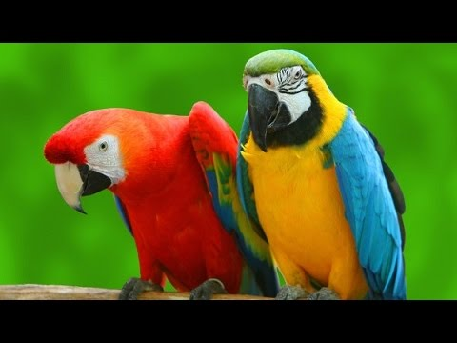
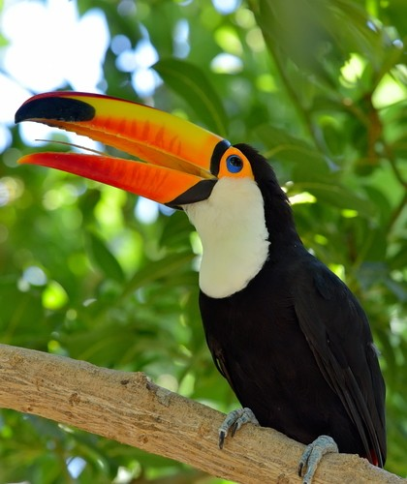
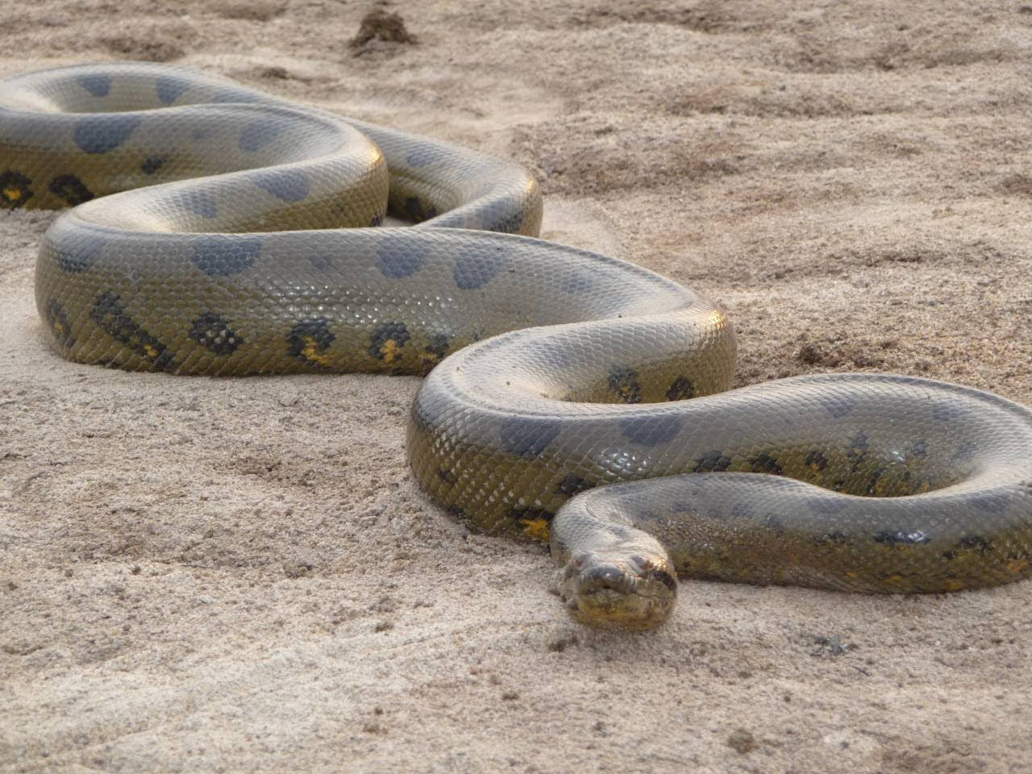
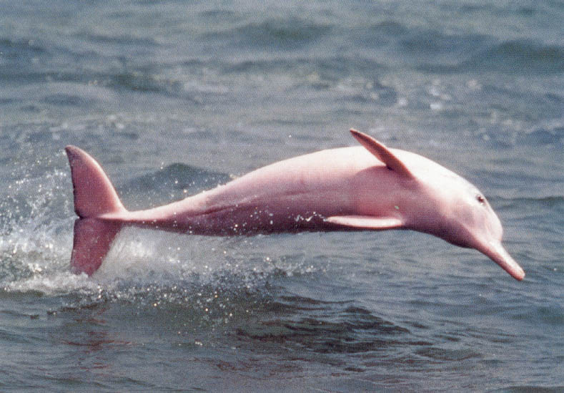
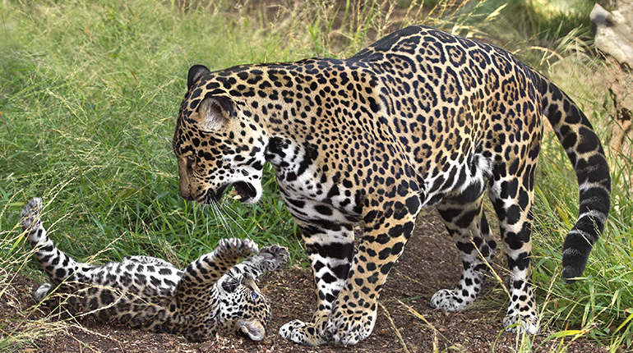
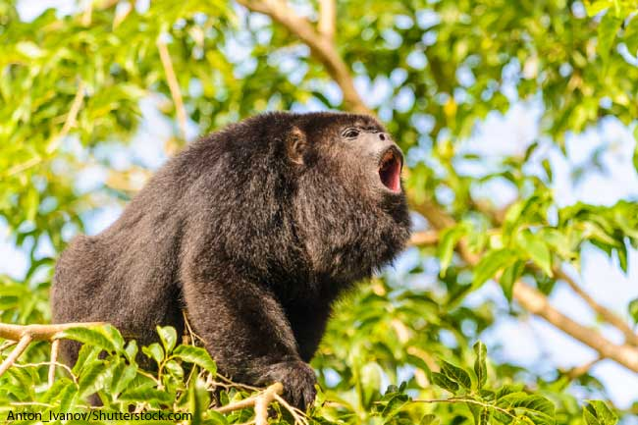
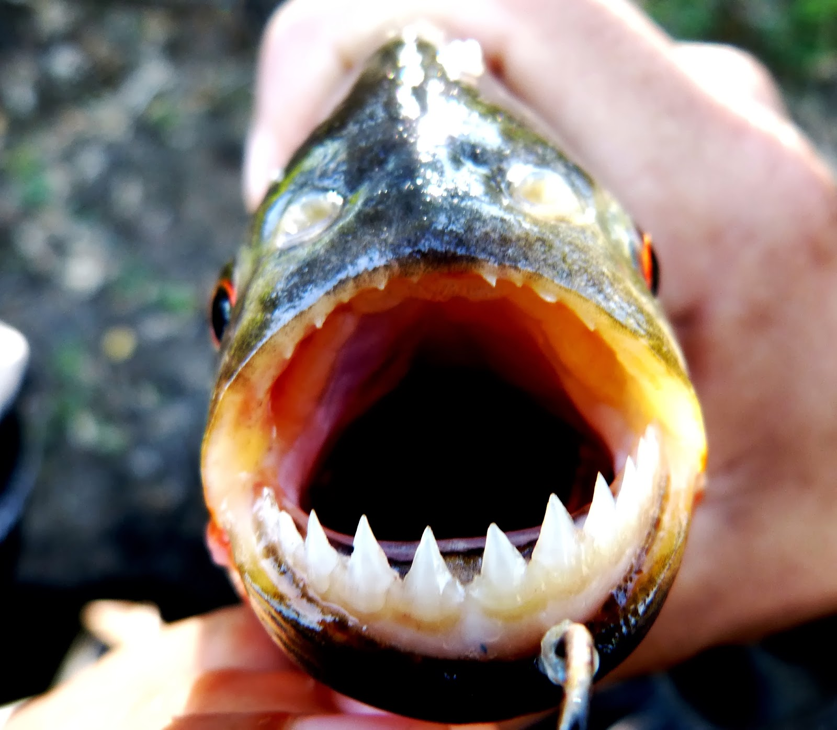
The Amazon
Tucan
Macaw
The largest Tropical Rainforest
10% of known species, 20% of bird species
The largest river in the world: the Amazon River
Origins of rubber
Anaconda
Piranha
Howler Monkey
Pink River Dolphin
Jaguar

Slide 7
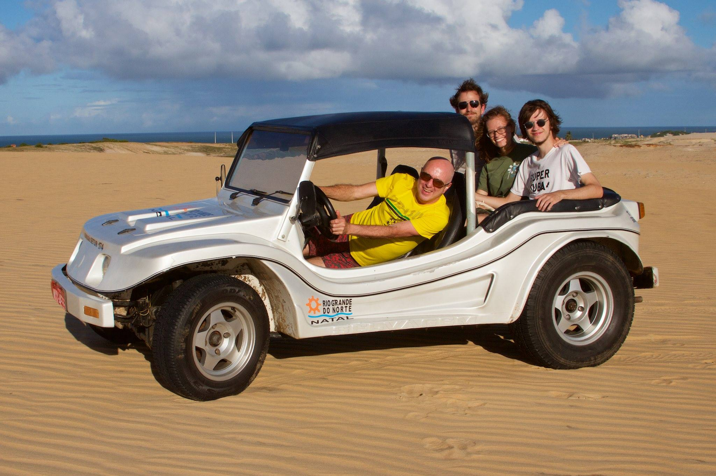
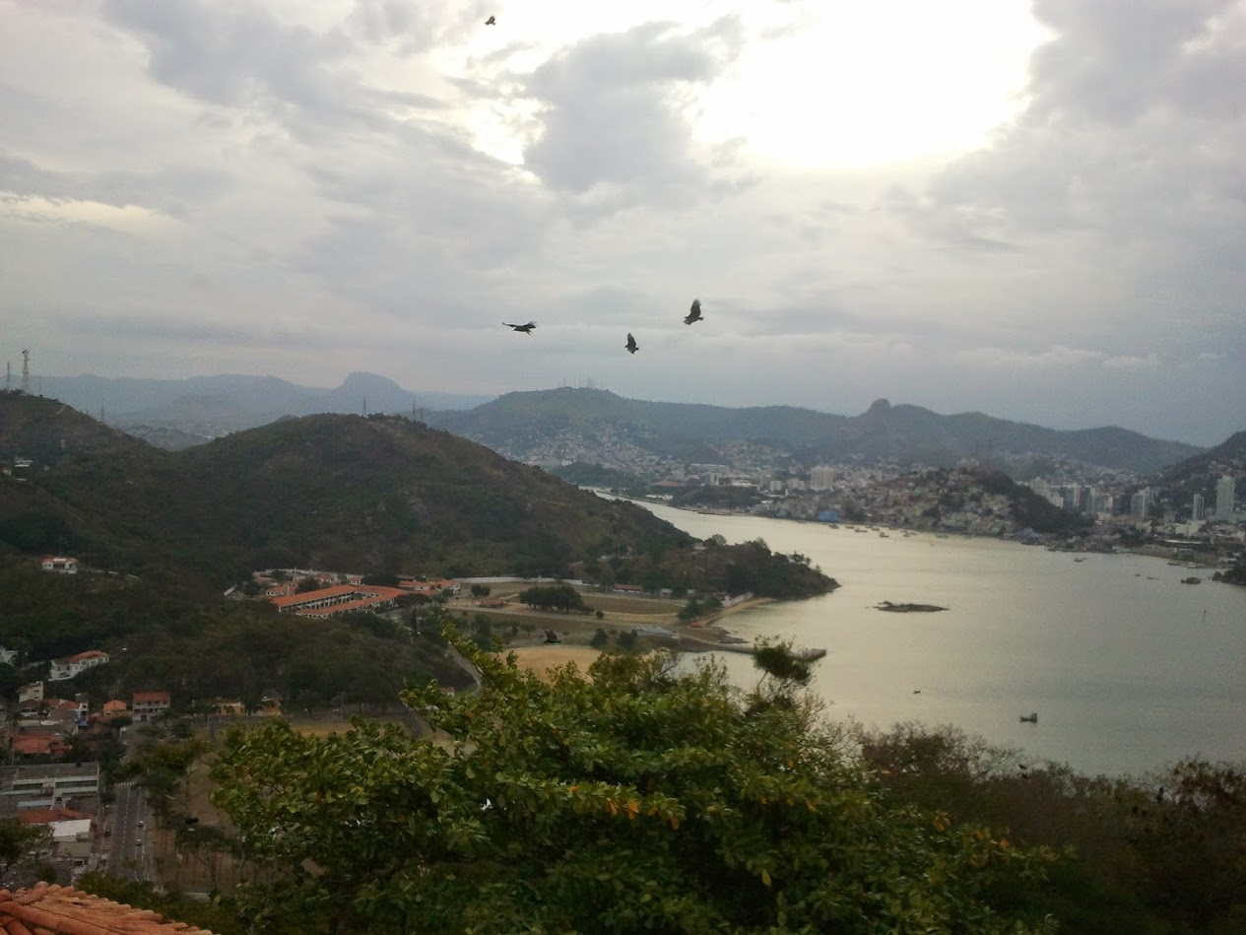
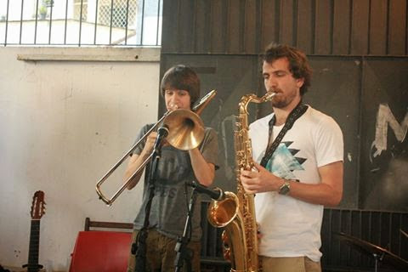
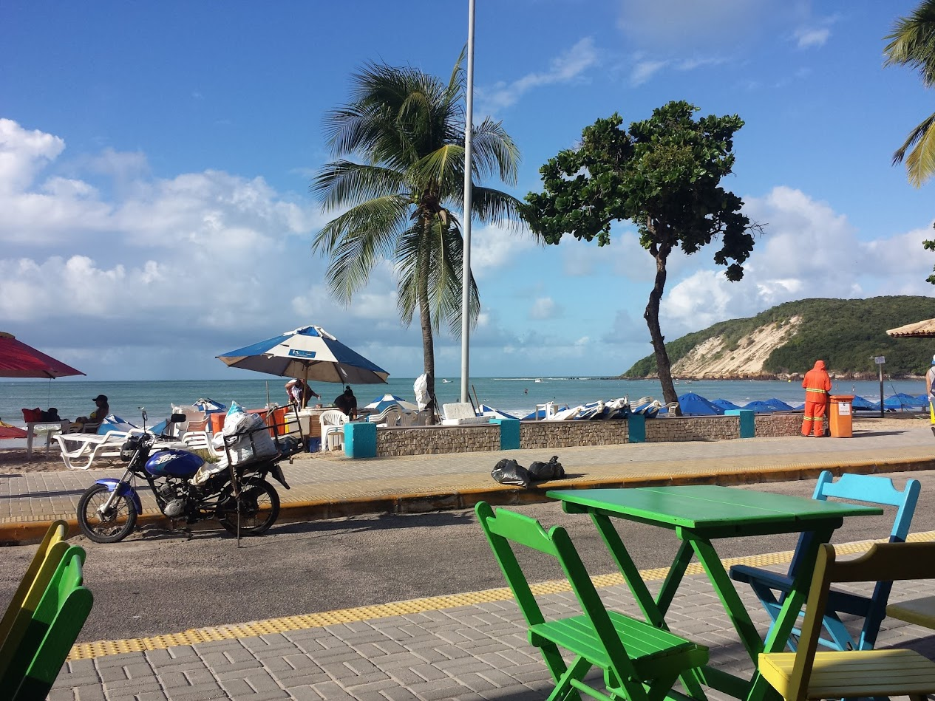
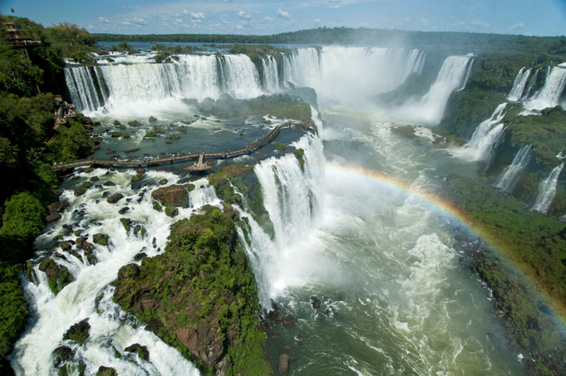
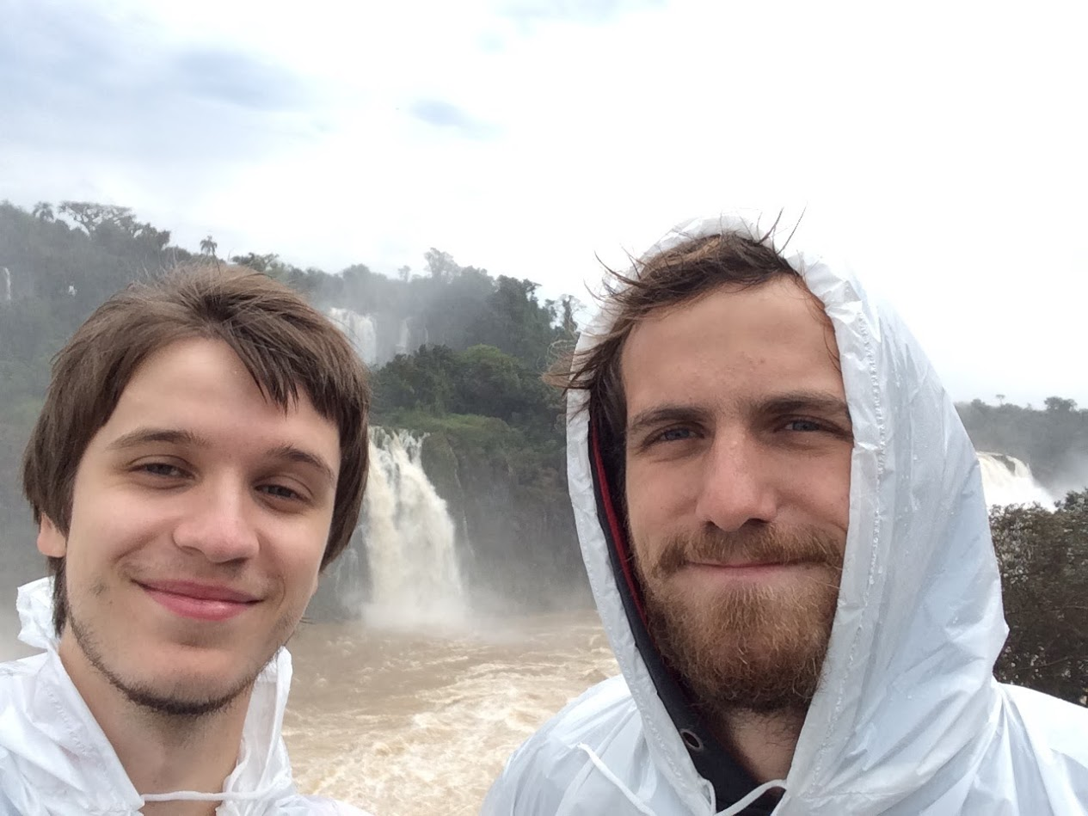

Slide 8
“Mama Eu Quero” – Carmen Miranda

Slide 9
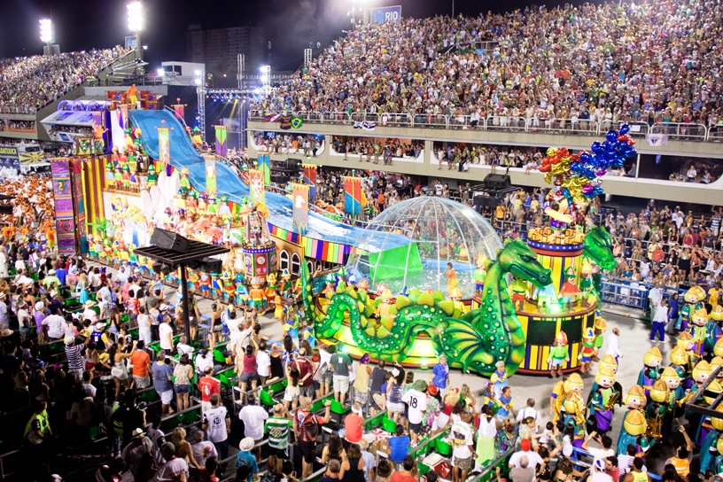
Carnaval!
Celebrate Lent
Parade
Competition:
Dress
Floats
Samba

Slide 10
Caixa & Surdo

Slide 11
Pandeiro
Like a tambourine

Slide 12
“So Danco Samba” – Tom Jobim
Form?

Slide 13
So Danco Samba
FORM: AABA
A:
So Danco Samba
So Danco Samba
Vai vai vai vai vai
So Danco Samba
So Danco Samba
Vai
B:
Ja Dancei o twiste ate demais
Mas nao sei
Me cansei
Do Calipso ao Cha Cha Cha

